Slide 1
Stock Price Prediction
Project on Machine Learning
Mentor : Team Members :
Mr. Neeraj Gupta Vishal Gaur (181500803)
(Assistant Professor) Kanhaiya Sharma (181500306)
Section : B (Batch-B1)
Group No. : 06

Slide 2
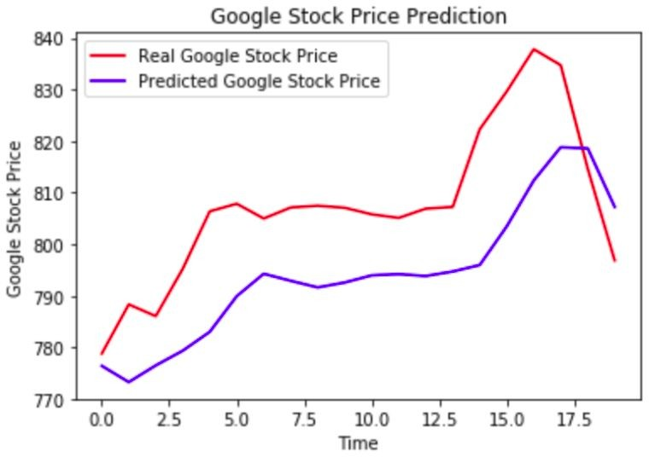
Stock Price Prediction

Slide 3

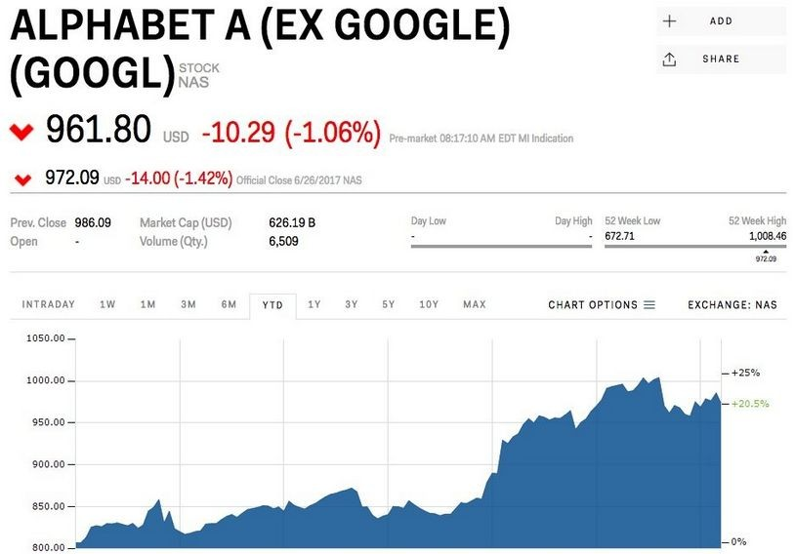
INTRODUCTION
A stock market is a public market for the trading of company stock.
Stock market allows us to buy and sell units of stocks (ownership) of a company.
If the company’s profits go up,then we own some of the profits and if they go down, then we lose profits with them.
●
If | more | sellers |  | than | buyers, stock
prices tend to fall. Conversely, when
more buyers than sellers, stock prices
tend to rise

Slide 4
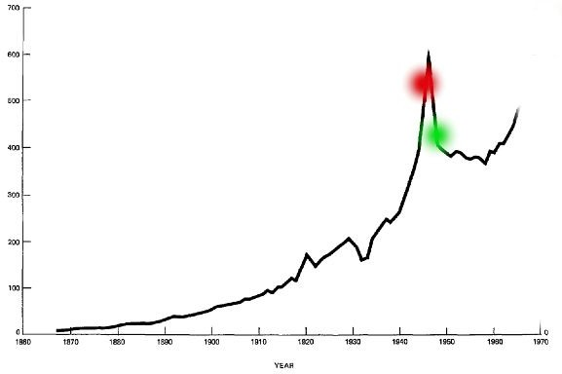
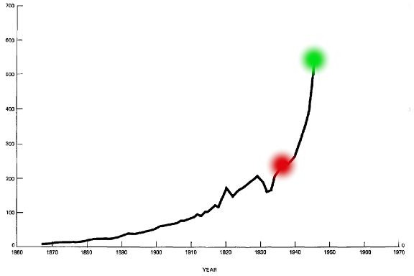
INTRODUCTION
Loss
Profit
Red is purchased stock Green is sold stock

Slide 5

HOW TO READ A STOCK TABLE?
Date- day on which the stock is traded
High- high is the highest price at which a stock traded during the course of the day
Close- refers to the last price at which a stock trades during a regular trading session
Open- price of the
first trade for any listed stock is its daily opening price.
Low- lowest price at which a stock trades over the course of a trading day.
Volume- the number
of shares or contracts traded in a security or an entire market during a given period of time

Slide 6
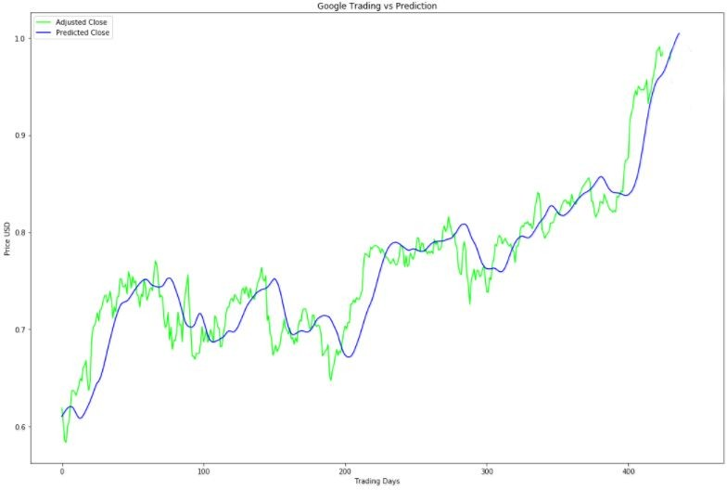


PROBLEM STATEMENT
Predicted Close price of Next day
To accurately predict the
closing value of a given stock across a given period of time in the future.
Today’s Close price
Use learning models compare
different machine and deep learning
available and them in terms of
graphical analysis.
Actual Close
Predicted Close
5

Slide 7
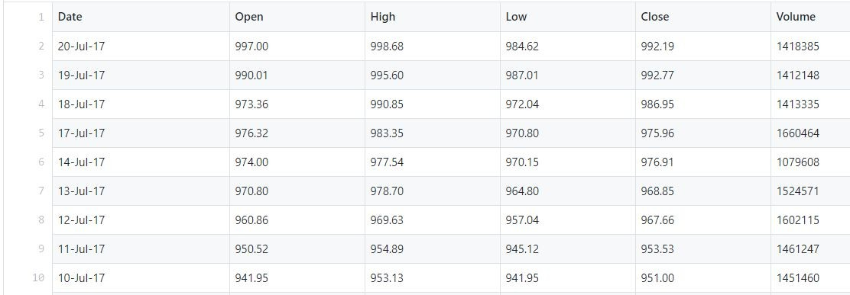
DATASET
The data used in this project is of the Alphabet Inc³ from January 1, 2005 to July 30, 2017, this is a series of data points indexed in time order or a time series. Our goal was to predict the closing price for any given date after training

Slide 8
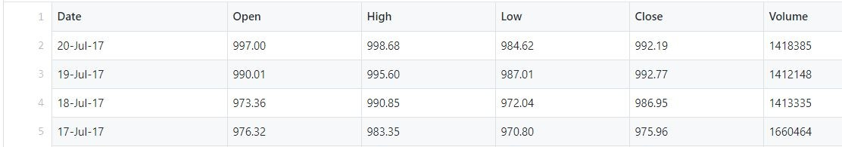
FEATURE IMPORTANCE
Process of selecting a subset of relevant features for use in model construction.
Feature selection methods include and exclude attributes present in the data without changing them.
Here, in our case ‘Date’,‘High’ and ‘Low’ attributes are dropped.
Dropped
7

Slide 9
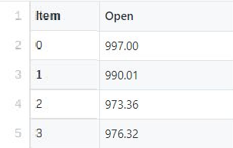
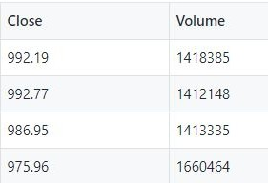
FEATURE IMPORTANCE
Process of selecting a subset of relevant features for use in model construction.
Feature selection methods include and exclude attributes present in the data without changing them.
Here, in our case ‘Date’,‘High’ and ‘Low’ attributes are dropped.
8

Slide 10


SO, WHAT ARE THE DIFFERENT MODELS AVAILABLE?

Slide 11
APPROACHES TO SOLVE
Linear Regression
Recurrent Neural Network + LSTM

Slide 12
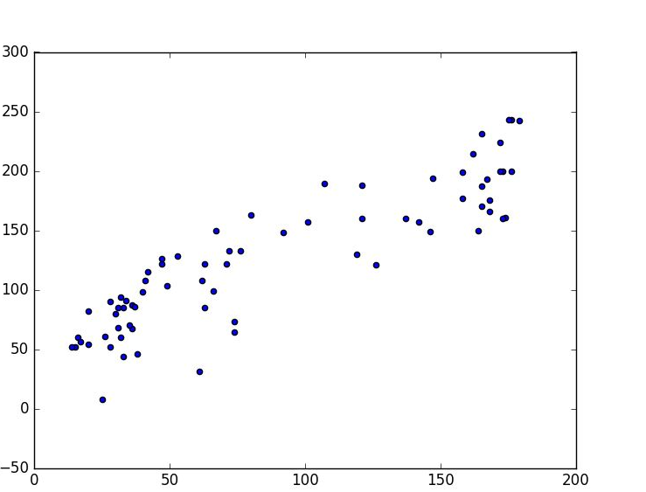

LINEAR REGRESSION
Now, you can predict Closing price along this line
Linear regression is an
approach for predictive modeling to showcase the relationship between a scalar dependent variable ‘Y’, (in our case, we have ‘Close’ attribute) and one or more independent variables ‘X’ (‘Trading day’ attribute).
Close
trading days

Slide 13
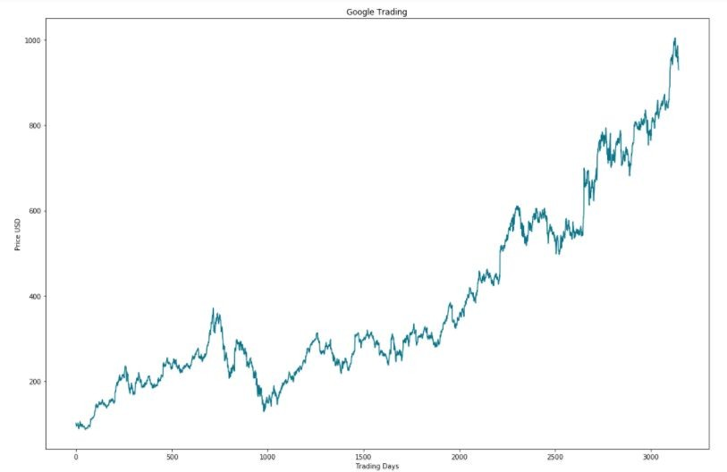

LINEAR REGRESSION
Predicted Close Vector
Day Vector
This equation represents this line
Weights
Bias
Initially, we will take some random weights and bias to initialize.

Slide 14
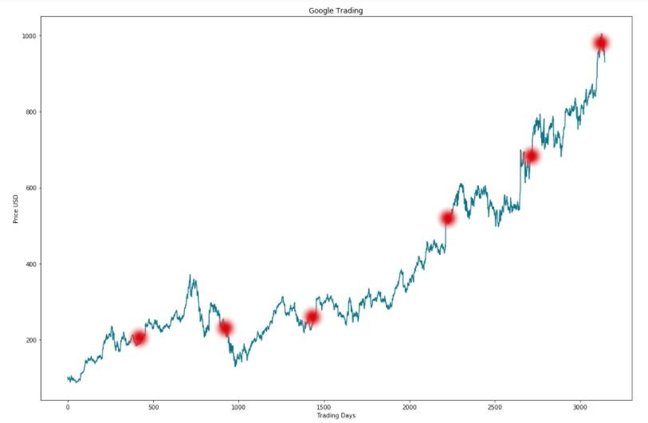

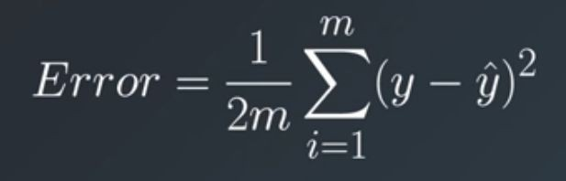

LINEAR REGRESSION
Initially, we have some random weight and bias, so it will look like this.
Next step, calculate the error.
14

Slide 15
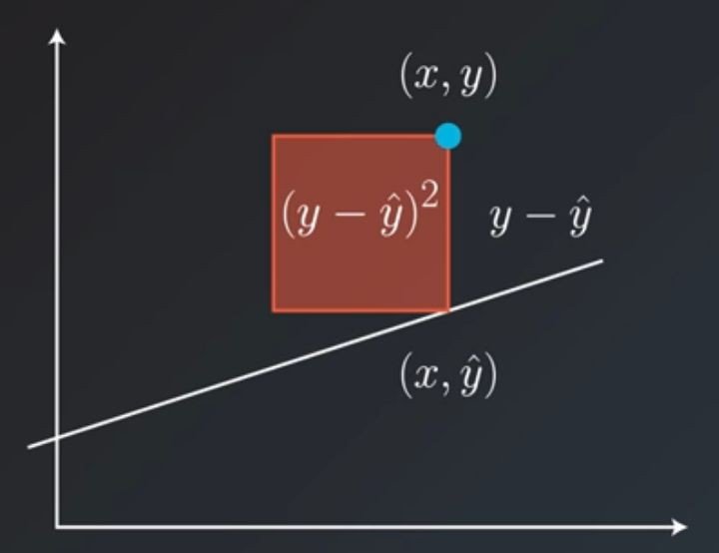
LINEAR REGRESSION
Mean Squared Error
Initially, we have some random weight and bias, so it will look like this.
Next step, calculate the error.

Slide 16
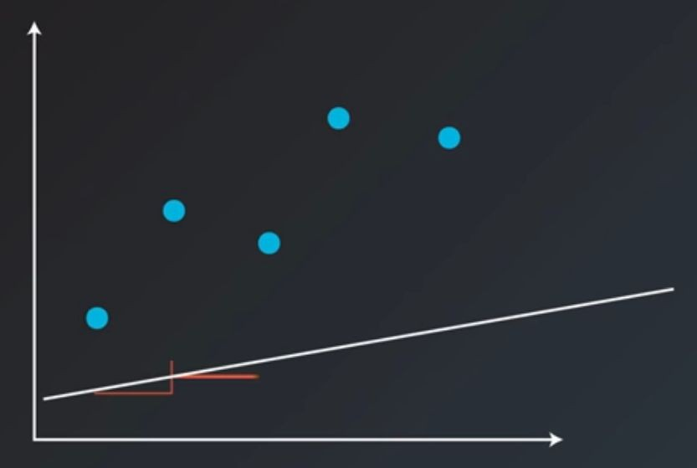
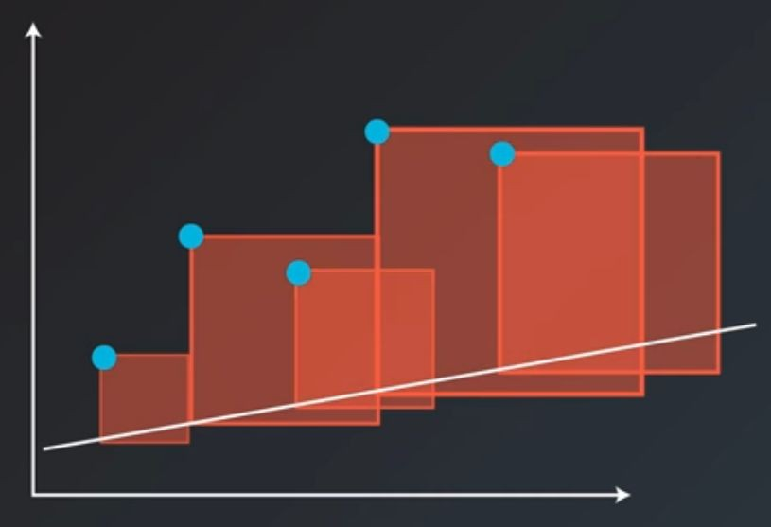
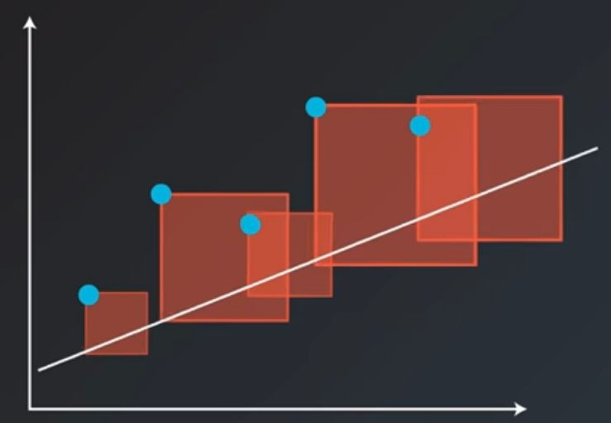



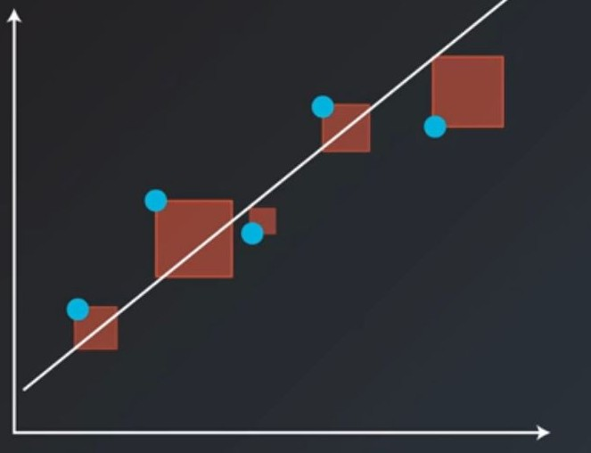
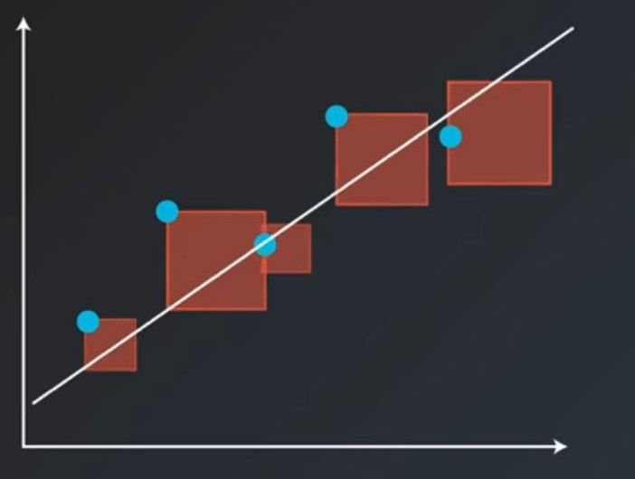
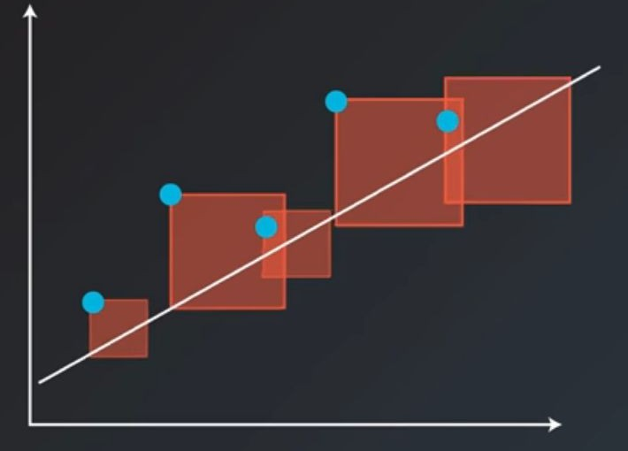

LINEAR REGRESSION

Slide 17
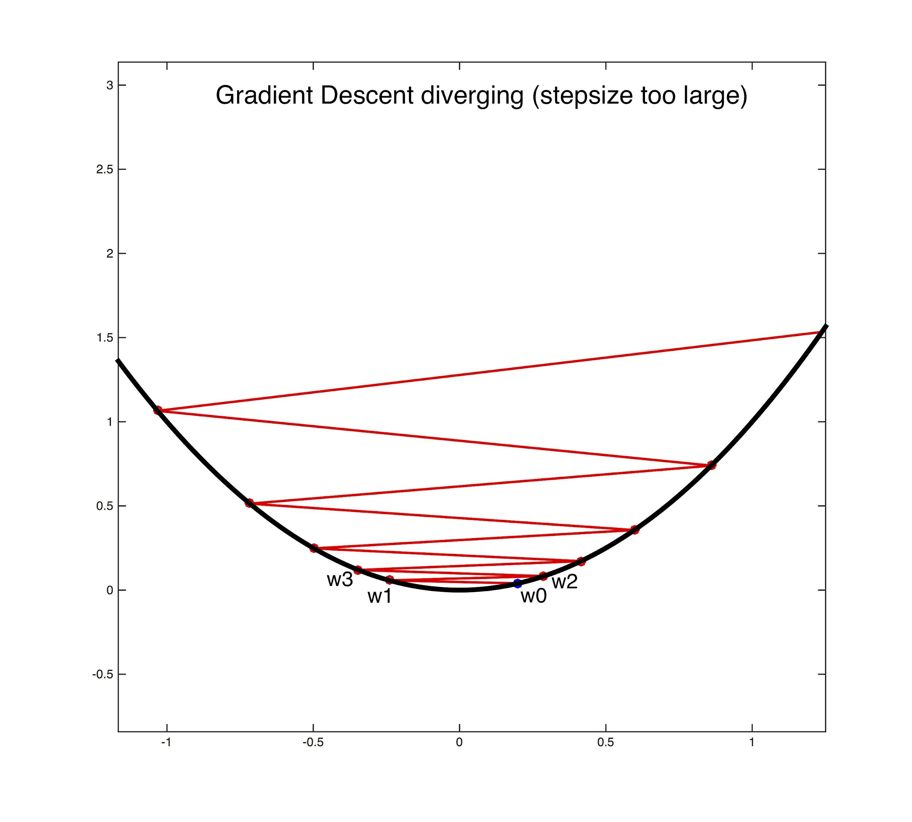
LINEAR REGRESSION
Mean Squared Error
17
we keep on repeating this process till we achieve the minimum error.
Weight = Weight - (n x Error ) Bias = Bias - (n x Error )

Slide 18
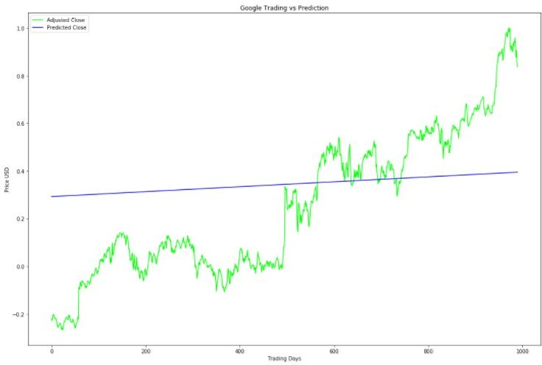
LINEAR REGRESSION

Slide 19
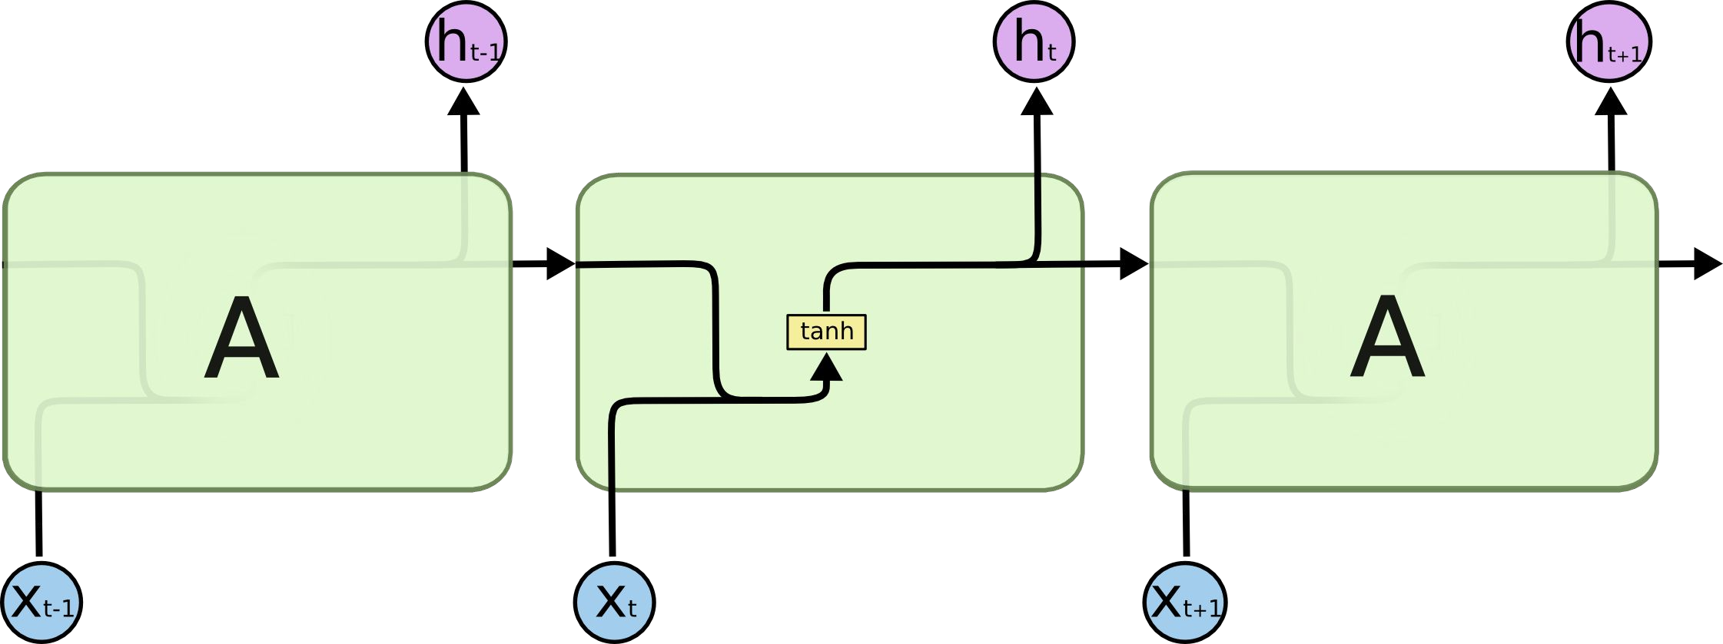

RECURRENT NEURAL NETWORK + LSTM
LSTM (Long Short Term Memory)
LSTMs are explicitly designed to avoid the long-term dependency problem. Remembering information for long periods of time is practically their default behavior, not something they
struggle to learn!
Recurrent Neural Network
LSTM

Slide 20
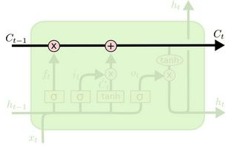
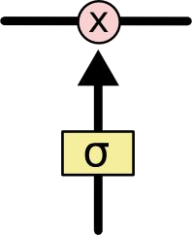
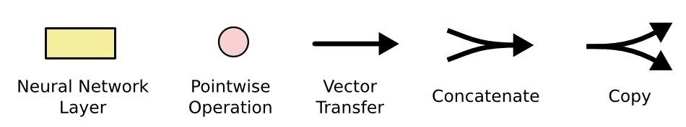
RECURRENT NEURAL NETWORK + LSTM
LSTM (How it works?)
The key to LSTM is the Memory cell state which stores the information. It runs straight down the entire chain.
LSTM has the ability to remove or add information to these cell state, regulated by structures called gates.
Gates are composed of sigmoid neural net layer and a multiplication operation.
Sigmoid layer outputs zero or one.
Multiplication operation
Sigmoid layer

Slide 21
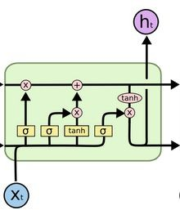
RECURRENT NEURAL NETWORK + LSTM
LSTM (How it works?)
There are three gates to protect and
control the cell states.
Input gate
Output gate
forget gate
input gate
output gate
forget gate

Slide 22
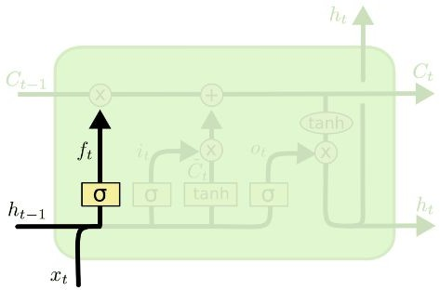

RECURRENT NEURAL NETWORK + LSTM
LSTM (How it works?)
First, forget gate looks at h_{t-1} and x_{t} and outputs a number between 0 and 1.
1 represents “keep the information” and 0 represents “remove the information”.
Past information of this state
Current closing Price

Slide 23
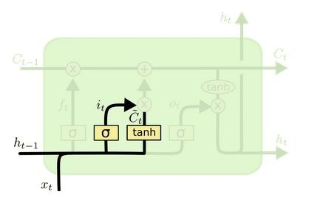
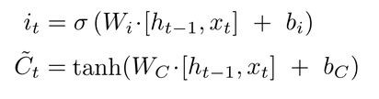
RECURRENT NEURAL NETWORK + LSTM
LSTM (How it works?)
First, forget gate looks at h_{t-1} and x_{t} and outputs a number between 0 and 1.
1 represents “keep the information” and 0 represents “remove the information”.
Second, input gate decides which values will be updated, in order to do that a tanh layer creates a vector of C_{t} (bar).
Combining these two, create an update to the state.
required for updating the weight

Slide 24
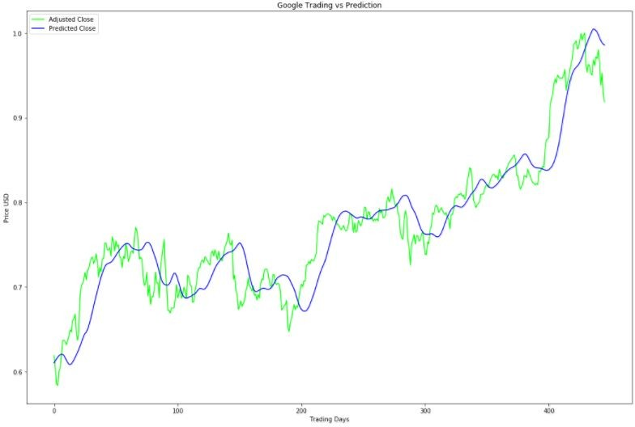
RECURRENT NEURAL NETWORK + LSTM

Slide 25
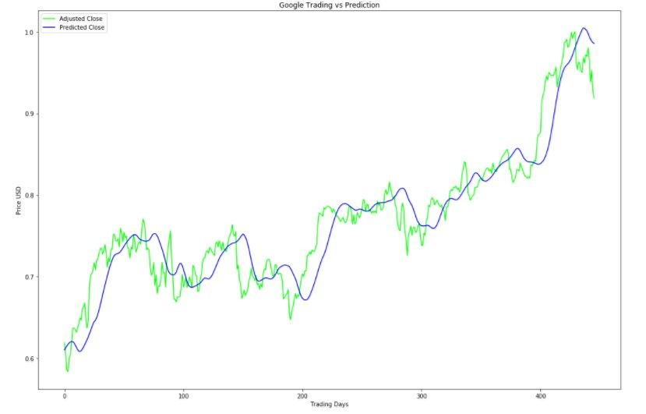
CONCLUSION
Linear Regression
Model does not fit properly
Stock price prediction is a complex problem and difficult to predict.
Machine learning model doesn’t perform well as compared to Deep Learning model.
Recurrent Neural Network + LSTM
Model fits properly

Slide 26
THANK YOU!

